Slide 1

Programming Paradigms
“Humans are allergic to change. They love to say, ‘We’ve always done it this way.’ I try to fight that. That’s why I have a clock on my wall that runs counterclockwise.”
- Grace Hopper
CS 3022 – Scanning and Parsing
Notes:
Many of these slides were adapted from a course given by Stephen Schulz.

Slide 2
Scanning and parsing
Role of Scanner and Parser
Work together to discover the syntactic structure of a program
This process (syntax analysis) is the first step in program translation or interpretation
Focus of the Book (and this class)
Emphasis on compilation rather than interpretation
Most concepts apply to both, or are irrelevant to interpretation

Slide 3
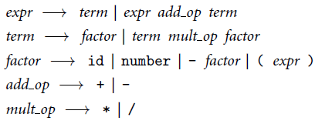
Example
We will use the following example for the next several slides. Can generate mathematical formulas.
How do we get the tokens used in this BNF?
id
number

Slide 4
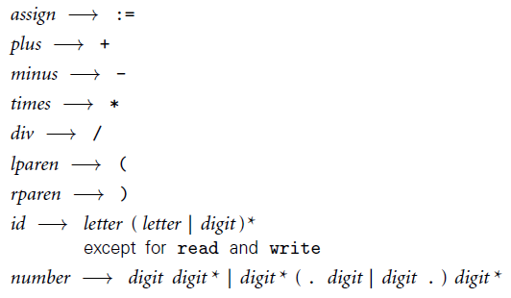

Scanning! Character stream to token stream
This regular language will split up a character stream into tokens.
Note 1: comments are not tokens, they are ignored.
Note 2: This tokenizer is used for an expanded grammar presented on the previous slide.

Slide 5
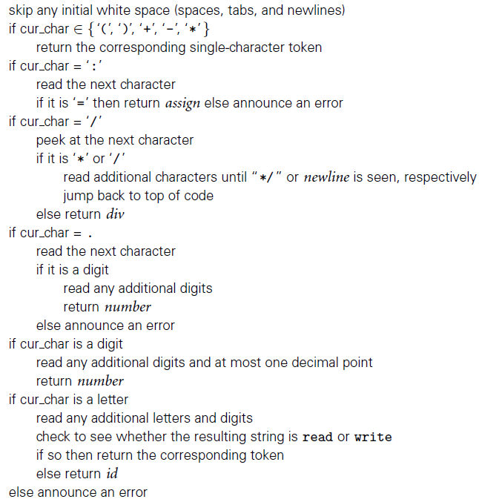
Lexer pseudocode

Slide 6
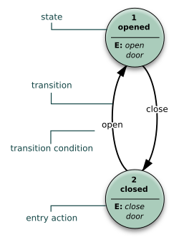
Finite state machine examples

Slide 7
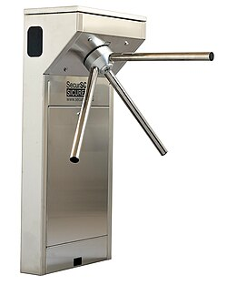
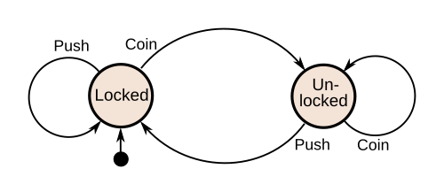
Finite state machine examples

Slide 8
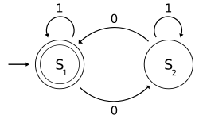
Finite state machine examples
Fig. 5: Representation of an acceptor; this example shows one that determines whether a binary number has an even number of 0s, where S₁ is an accepting state and S₂ is a non accepting state. (source: Wikipedia)

Slide 9
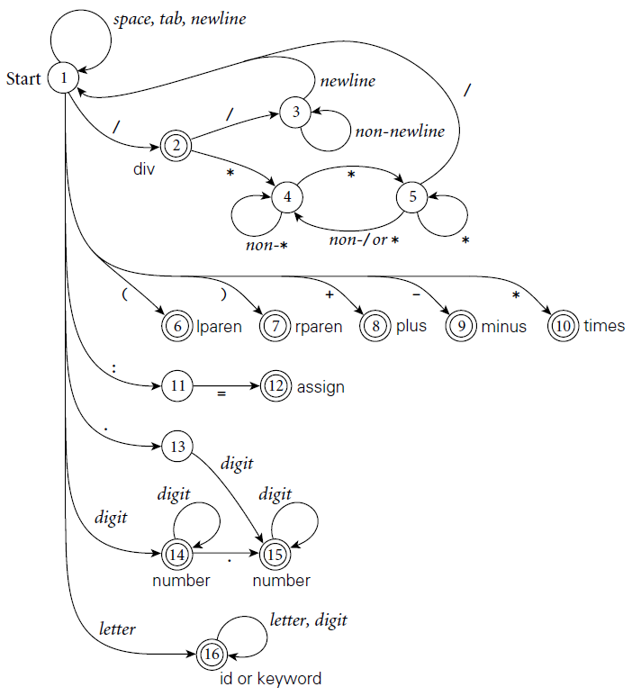

Slide 10
Introduce lab

Slide 11
Role of the Parser in Compilation
Core component of a compiler
Calls the scanner for tokens → builds syntax tree
Passes tree to later phases (semantic analysis, code generation, optimization)
Directs the compilation process (“syntax-directed translation”)

Slide 12
Parsing & grammars
CFG = generator of a language
parser = recognizer
General parsing runs in O(n³) → too slow for real programs
Many grammars allow linear-time parsing

Slide 13
LL vs. LR Parsers
LL: Left-to-right, Left-most derivation
Simpler, easier to understand
Can be hand-written or tool-generated
LR: Left-to-right, Right-most derivation
Covers more grammars, intuitive for arithmetic
Almost always tool-generated
More common in production compilers

Slide 14
Look-Ahead in Parsers
Notation: e.g., LL(2)
Number = tokens of look-ahead needed for parsing
Most compilers: 1 token is enough
More look-ahead = helpful in some cases
Example: ANTLR (Terrence Parr) uses multi-token look-ahead → expands range of top-down parsing

Slide 15
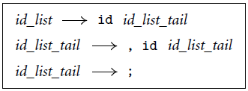
Example Grammar
Matches:
A;
Albuquerque;
A, B, C;
rumproast, galoshes, pogostick;

Slide 16
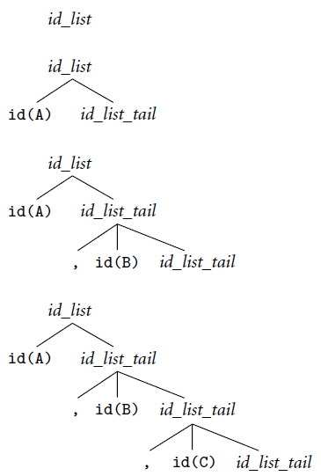
Top down LL(1) Parsing: A, B, C;

Slide 17
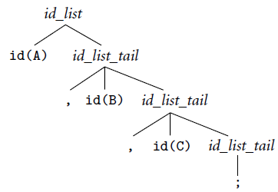
Top down LL(1) Parsing cont.: A, B, C;

Slide 18
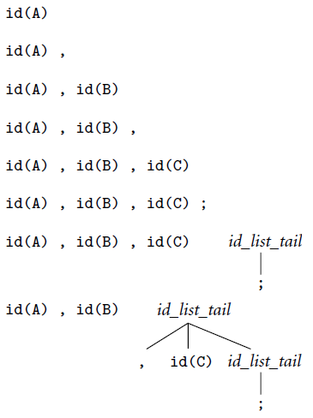
Bottom up Lr Parsing: A, B, C;

Slide 19
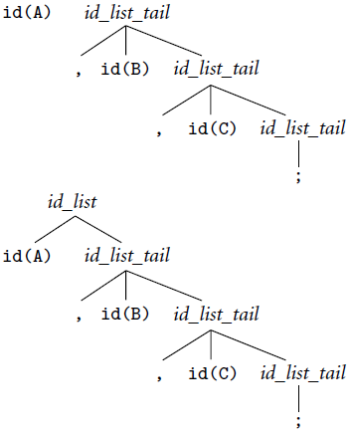
Bottom up Lr Parsing cont.: A, B, C;

